Slide 1
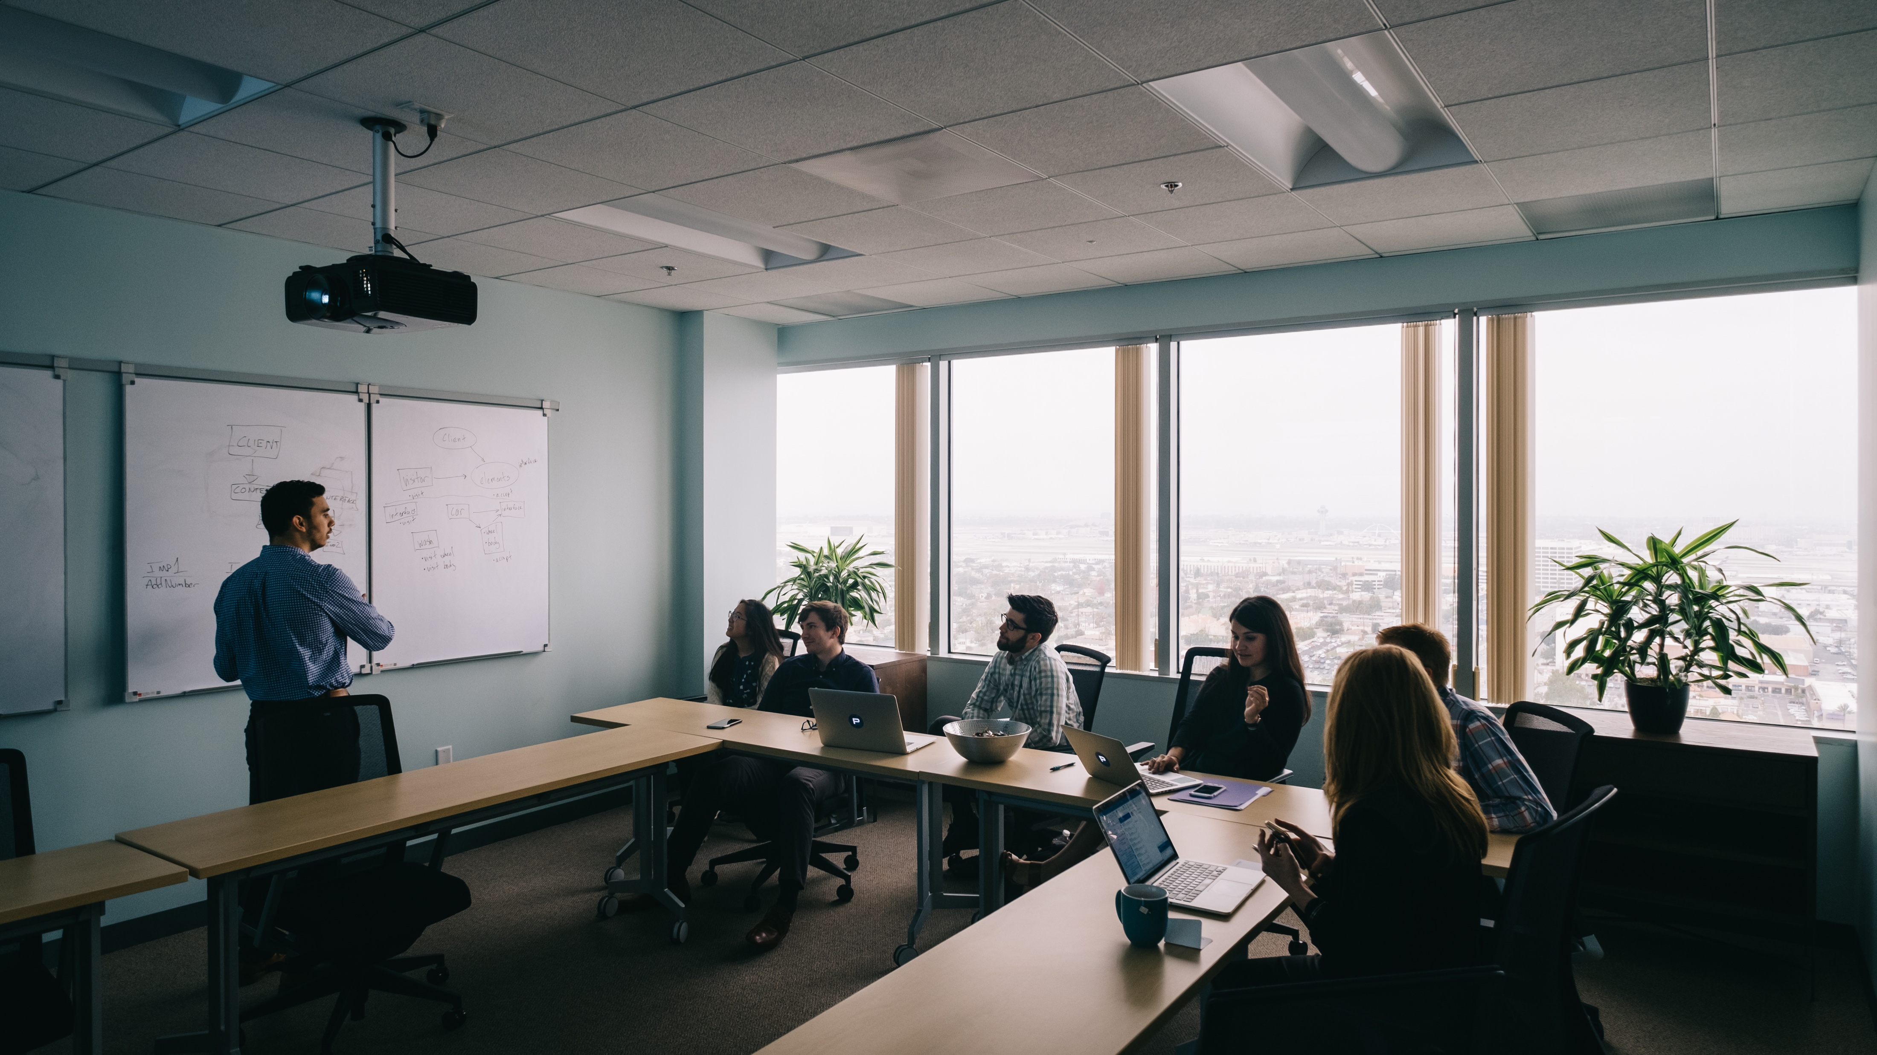
WHAT WE’VE HEARD
“
Better alignment amongst teams
Need better tools for patient capture during intake process
“
Are we doing a great job and what aren’t we catching?
Leverage new pricing models to capture new business
Shore up data needs and issues
How do we optimize infusion management?
Retain, grow, and attract business
How do we drive differentiation in the marketplace?
Notes:
Brian

Slide 2
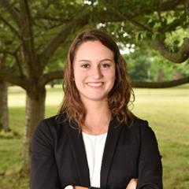
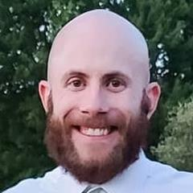
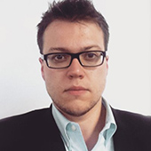
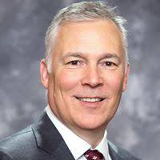
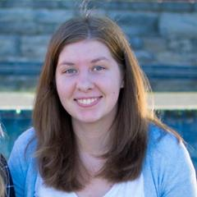
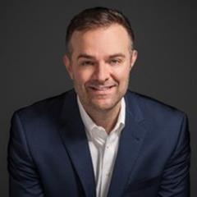
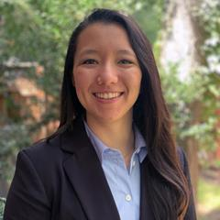
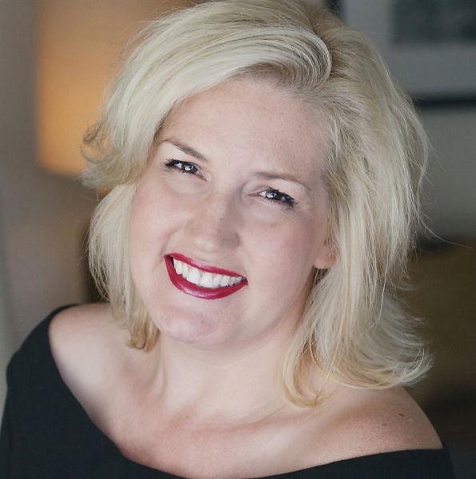
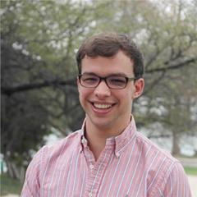
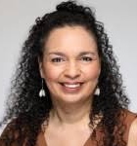
* Alphabetical by first name
ALLY
RENEHAN
MySoberCompanion What the HACK TEAM
ANTHONY
PEROZZE
IGOR
GEYFMAN
BRIAN
ERICKSON
MADISON
WHEELER
BRIAN
ORRELL
KIRI
CHUNG
COURTNEY
COLE
SEAN
BLONIEN
GRISELLE
COLON
Notes:
Brian

Slide 3
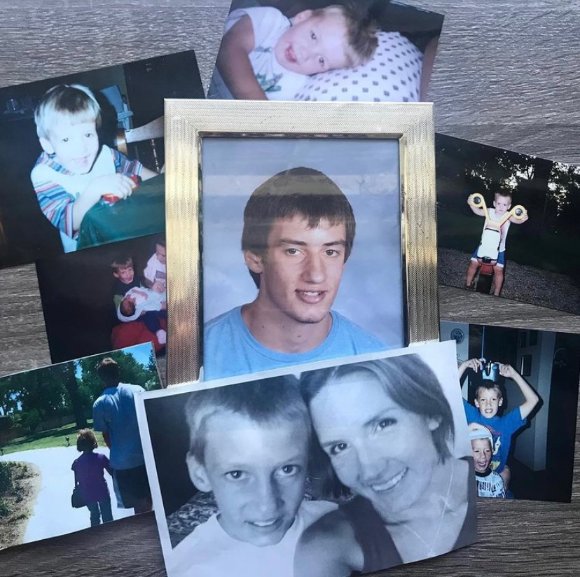
Walking through our product as Team Gunner
A face of addiction
Notes:
Tiffany and Daniel

Slide 4
INTRODUCTION: MYSOBERCOMPANION
“
positive reinforcement...Anything that will help keep the patient focused on the path ahead
Envision multiple paths to help patients achieve sobriety
“
How do we rebuild trust in the patient?
Leverage existing sobriety Apps to find efficiency in development
AI and Machine Learning as a point of differentiation
gamification is a powerful tool to acquire, retain and engage users
Mobile detection of drug use with wearable biosensors
Notes:
Brian – send deck to Brian

Slide 5
“
TRUSTED
A New Approach to Addiction Recovery, offering a customized path to sobriety while rebuilding a patient's reputation to enable their transition into society.
Notes:
Brian – send deck to Brian

Slide 6
Technology
The Dev Team:
3: C1 1: C2
1: A2

Slide 7
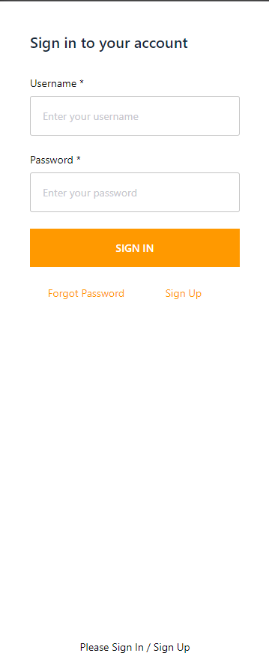
Login Screen
Things to note:
Wanted easy to register and use so eliminate email and password and just enter phone number with a link to autologin
Notes:
Tiffany and Daniel

Slide 8
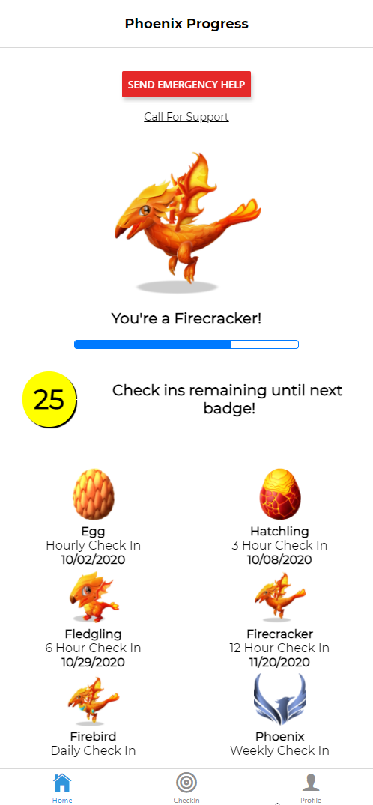
Home Screen
Things to note:
When the patient is triggered and feels to urge to use, there is support at the touch of a button
Always want Emergency Help readily available for overdose scenarios
Want to encourage viewing their recovery as an ongoing process with positive encouragement along the way
Can see where they are but also where they CAN be in the future
Notes:
Tiffany and Daniel

Slide 9
Check In Screen
Things to note:
Want a simple interface but let the user know what information they will be sharing
Location information allows the Support Team to build trust
Allows space for additional health vitals to be stored
Notes:
Tiffany and Daniel

Slide 10
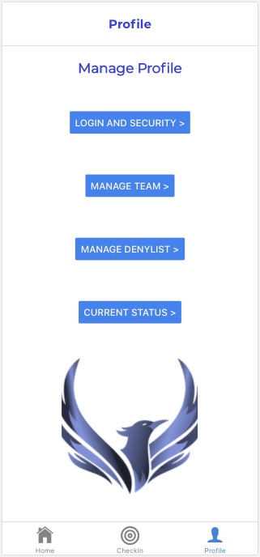
Profile Screen
Things to note:
Allows the Phoenix (and the Support Team) to manage:
Log in information
Add/Remove Support Team Members
Deny List Contacts & Locations
Notes:
Tiffany and Daniel

Slide 11
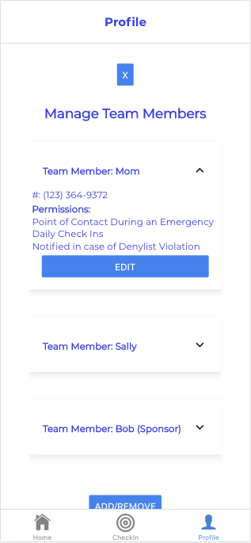
Managing Team Members
Things to note:
* The patient will select who their team will be and give them access.
* The patient has control over who sees their information in compliance with HIPPA laws
Notes:
Tiffany and Daniel

Slide 12
Q&A
Notes:
Tiffany and Daniel

